Slide 1

Before we start …
For those that have not created your AWS account, you can do so now
Note that you have to attach a payment method, you can just listen through if you are uncomfortable with it
*** A few things to take note

Slide 2
Amazon Sagemaker
Philip Lee | 15 Sep 2022

Slide 3


MLDA@EEE
AY2022/23
Notes:
MLDA@EEE is a student centric lab which aims to provide a platform to empower our EEE/IEM students to learn and deploy ML and DA skills and knowledge in both academia and industry. We do so through our various events, project and activities.

Slide 4

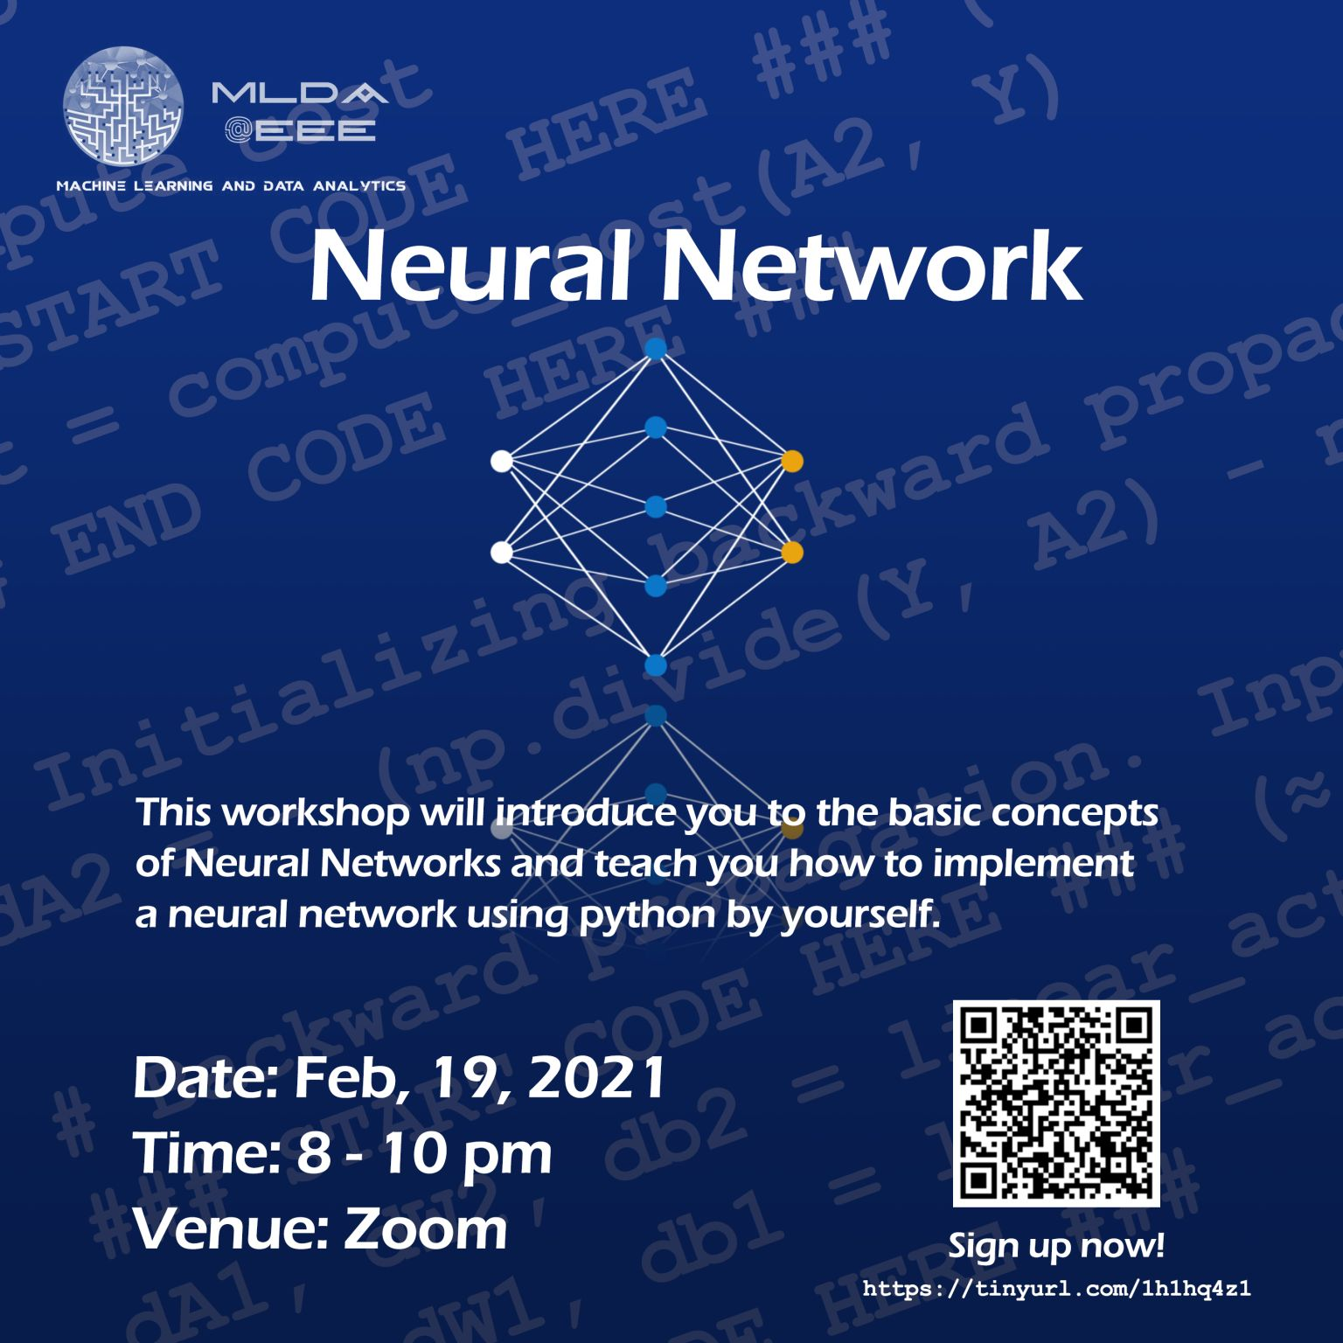


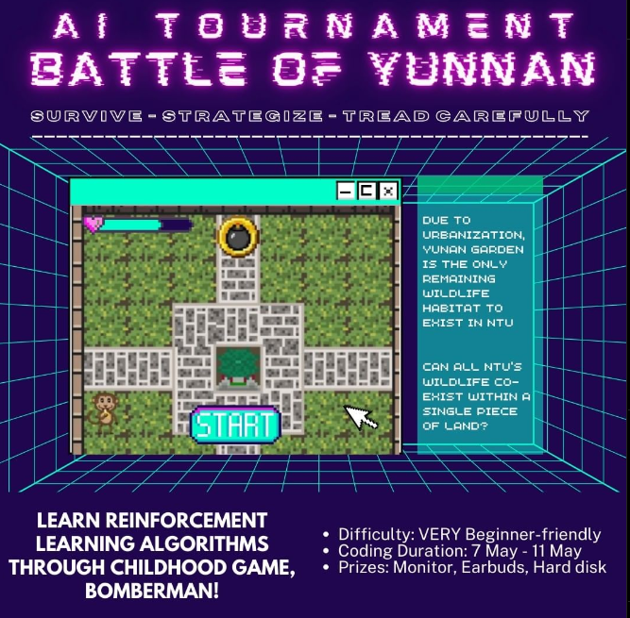
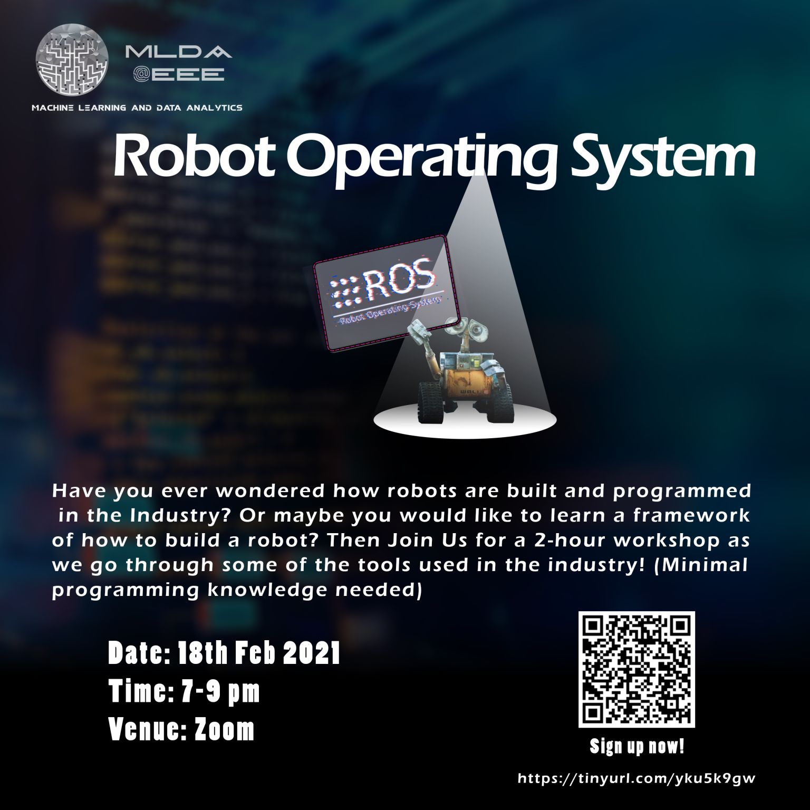

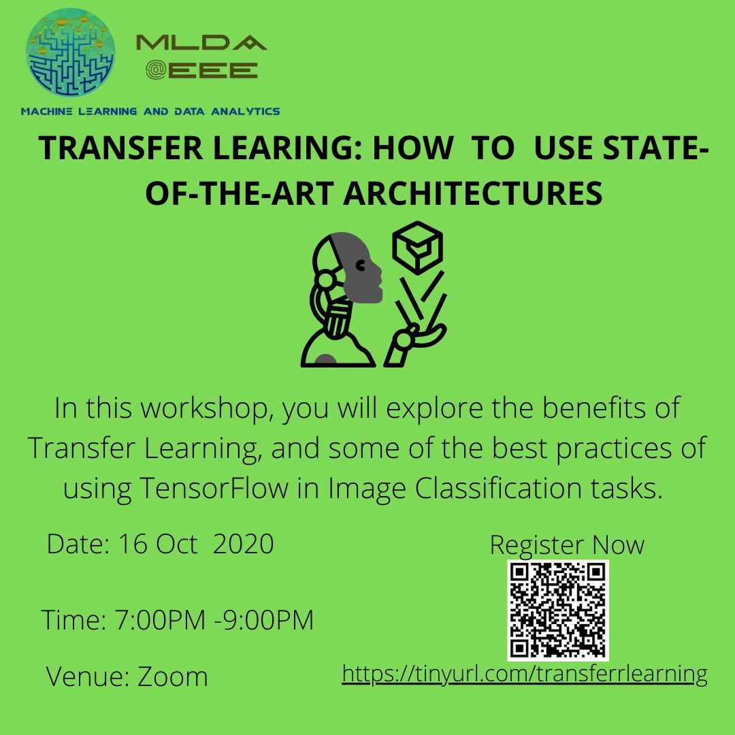



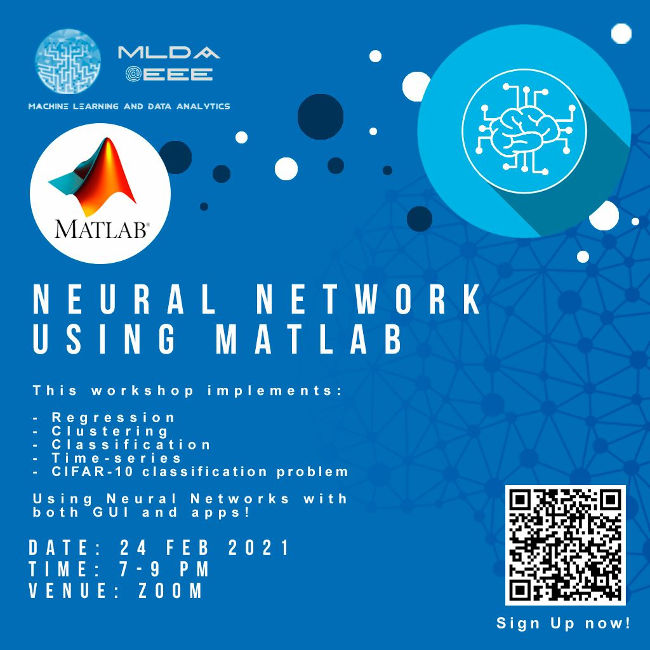
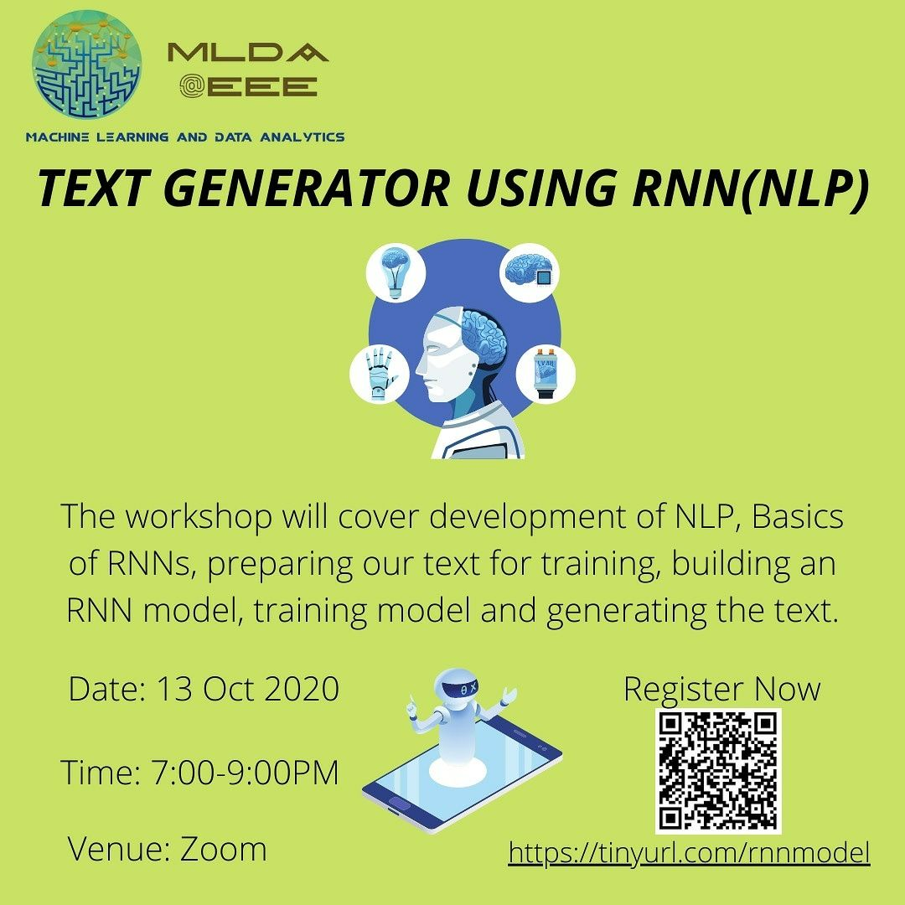

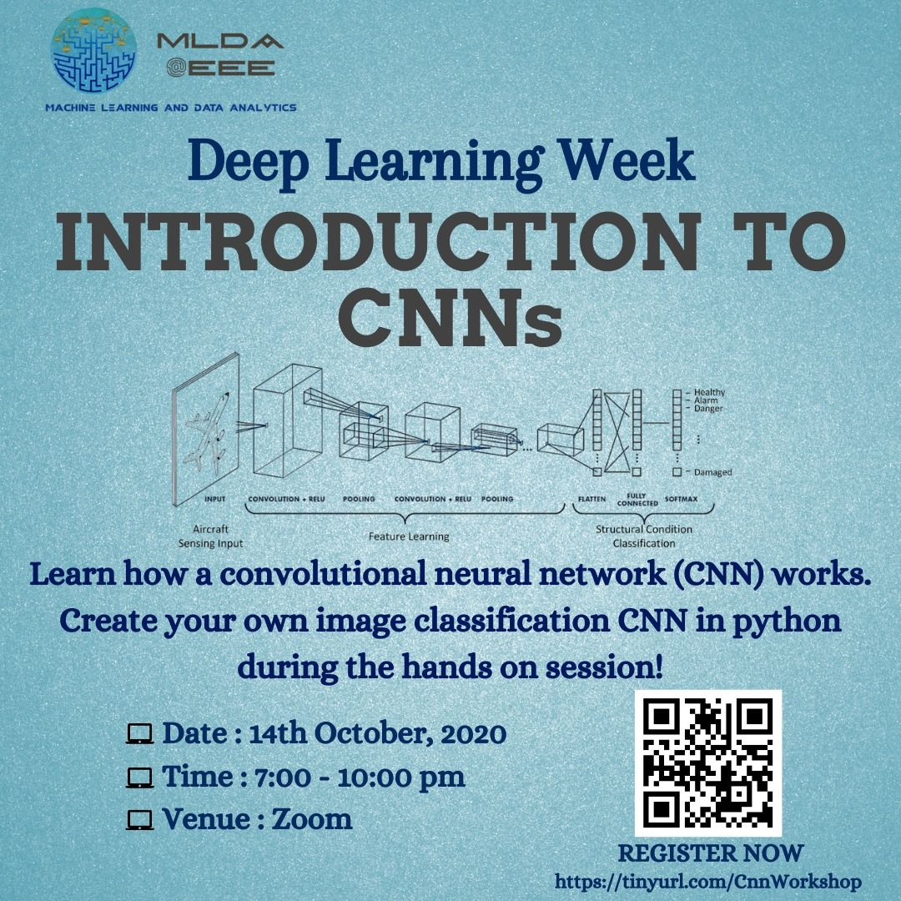

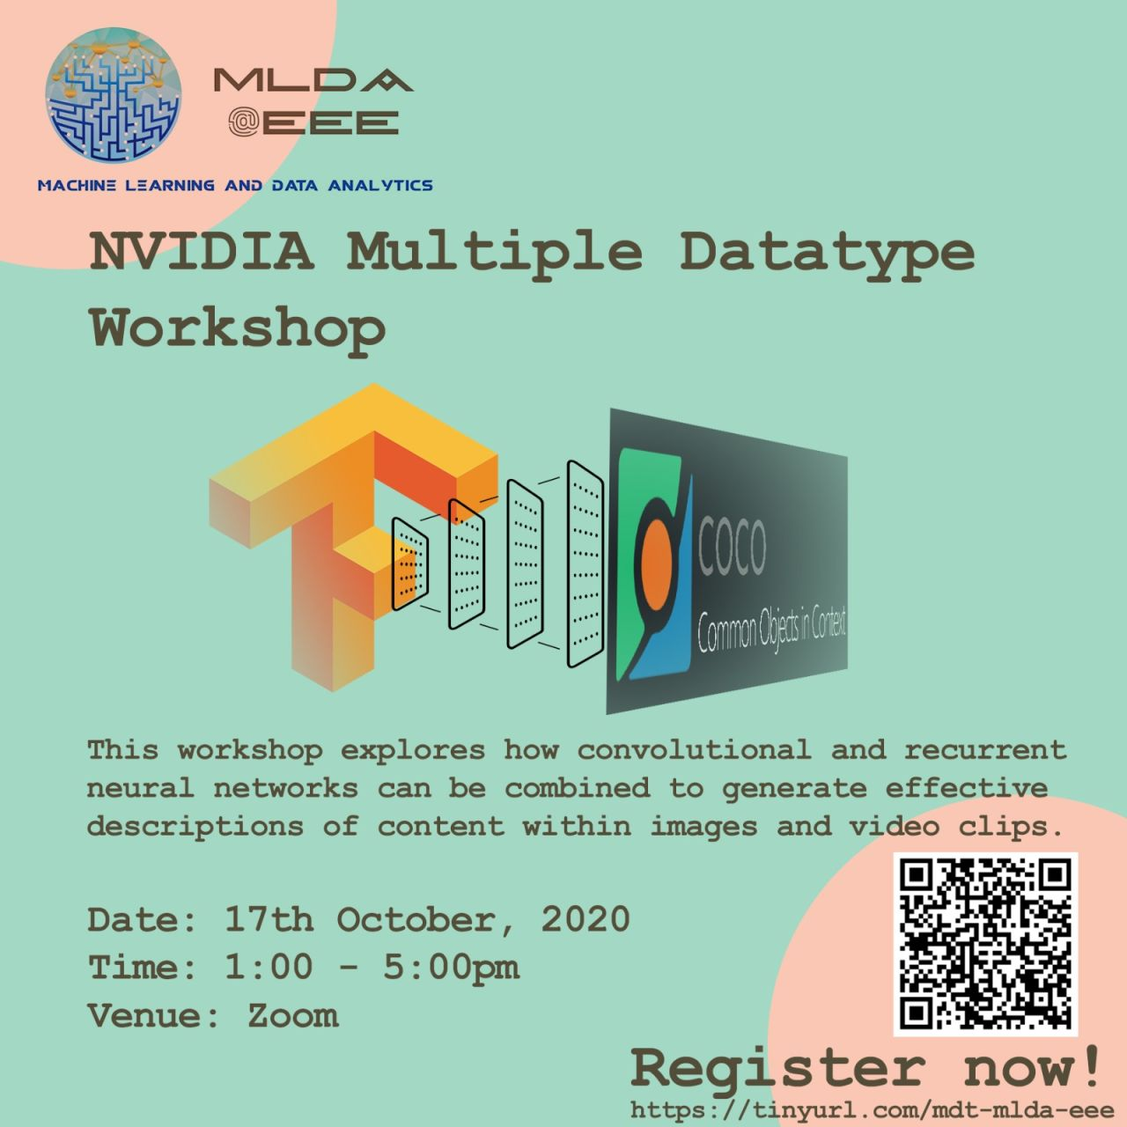
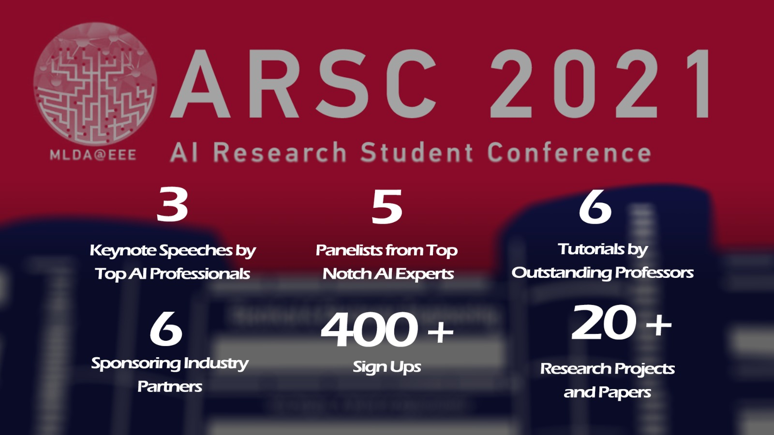

What we do
LEARN
APPLY
CONNECT
Listen to our workshops
Do projects that belong to yourselves
Hear from the industry
Notes:
MLDA@EEE is a student-led club, that aims to provide a platform to empower NTU students to pursue the application of Machine Learning, Data analytics and artificial intelligence. We do so by providing them with a place to learn, apply and connect with our industry partners and the academia

Slide 5
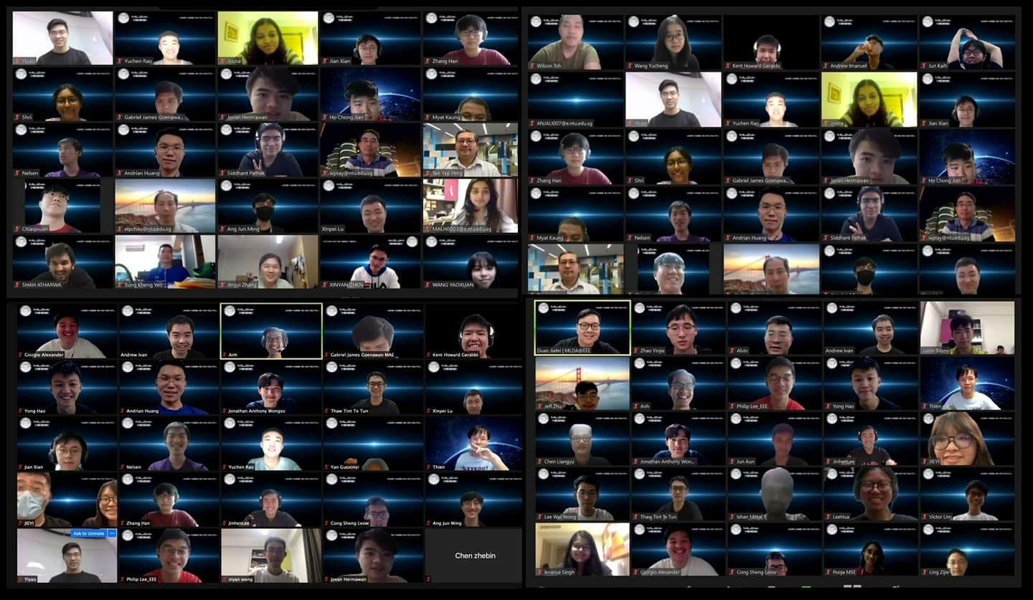
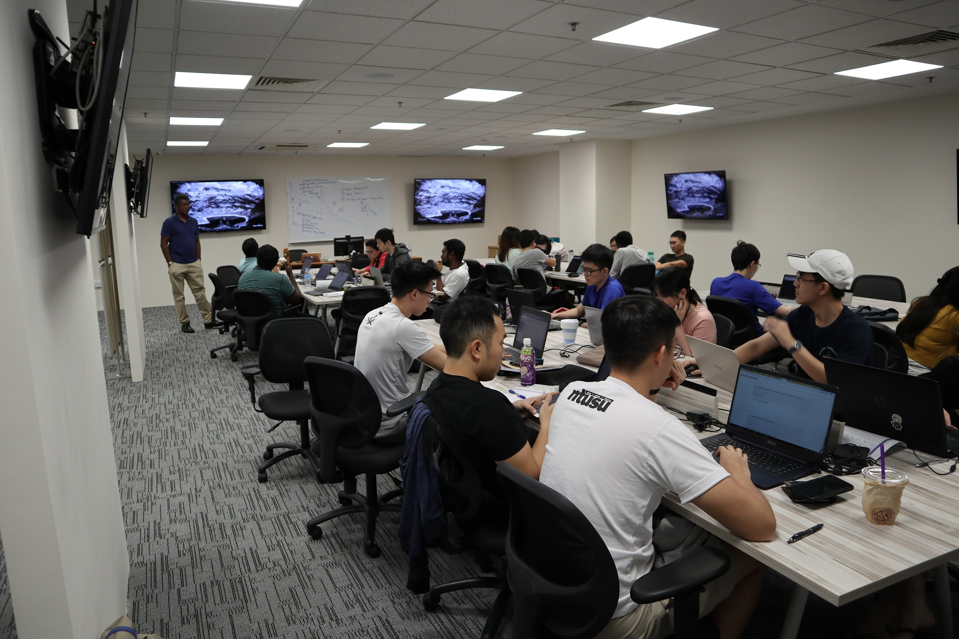
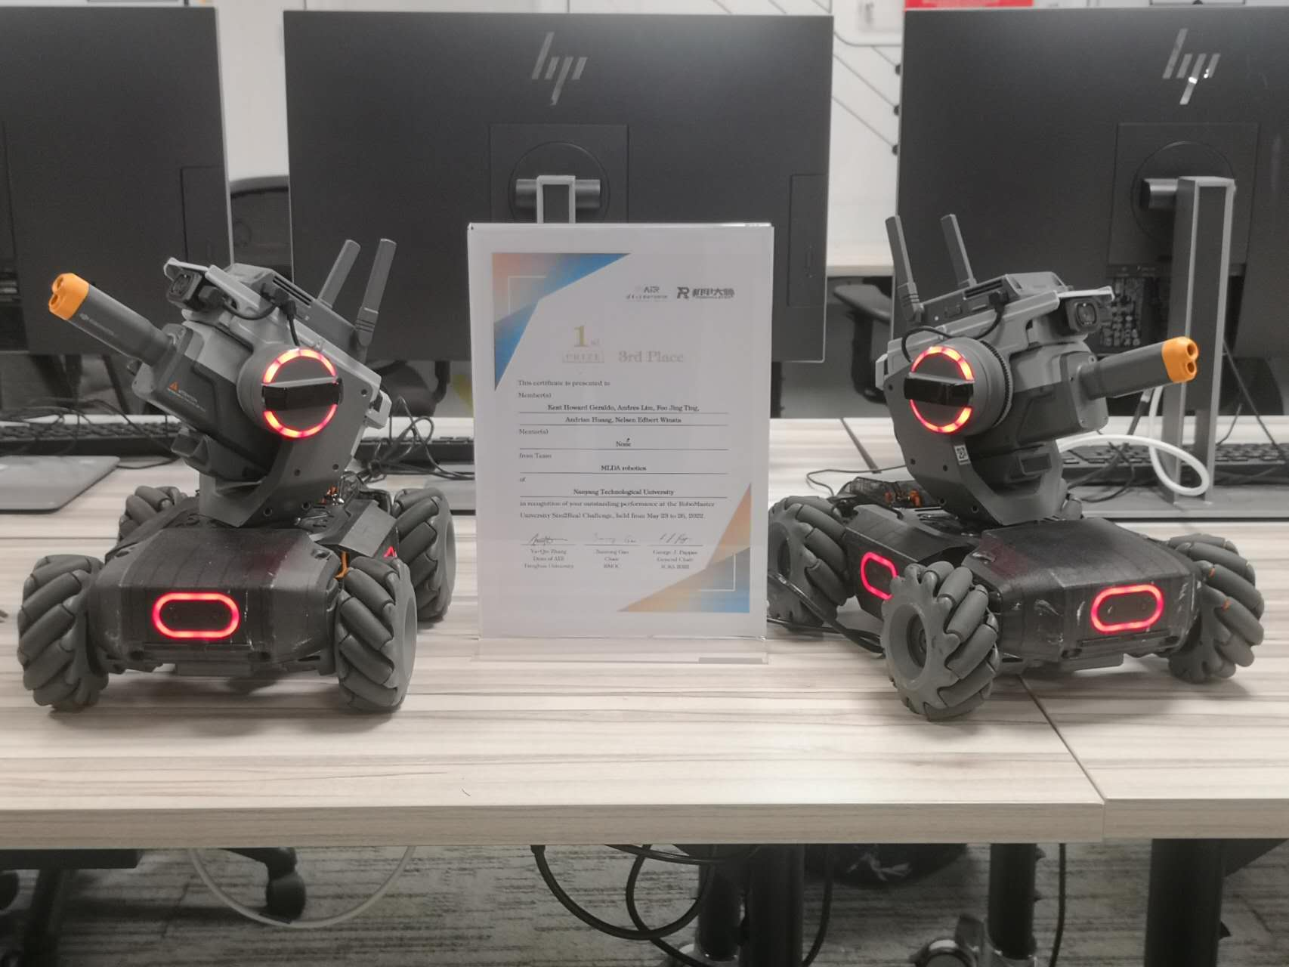
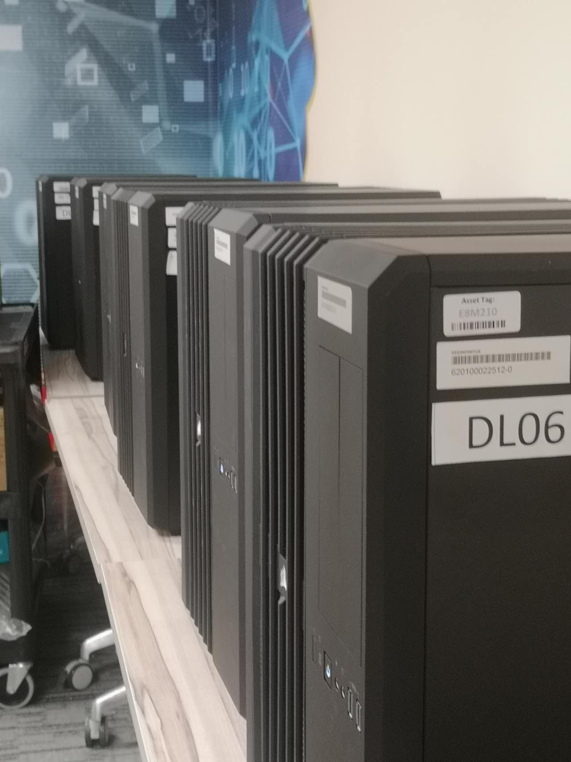



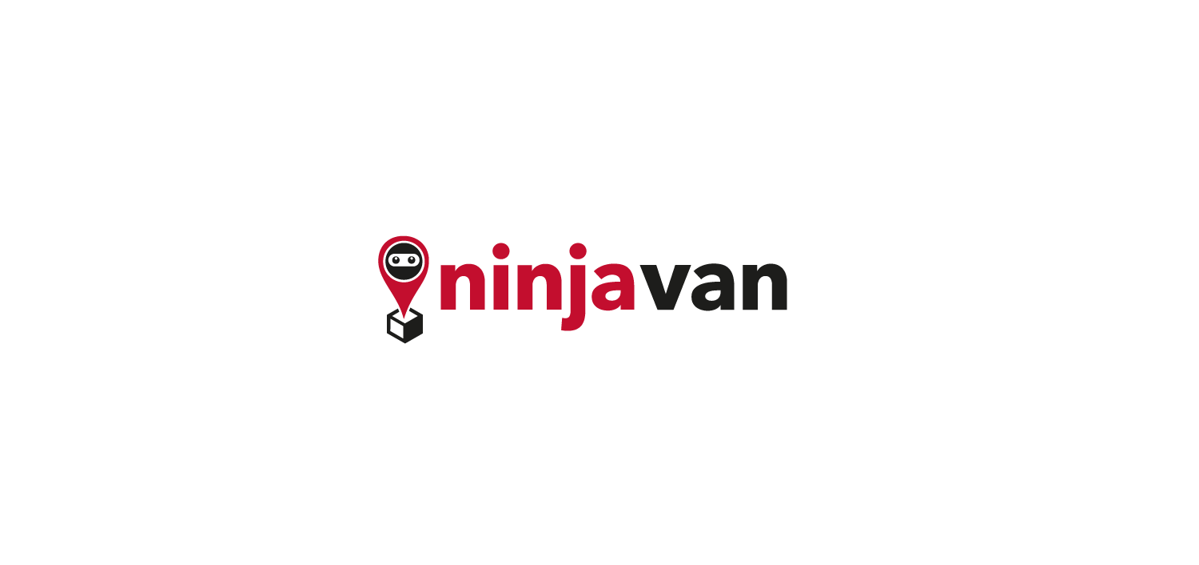










What we have
Like-minded Students in NTU
Project Partner / Research Partner
Friends in similar path of personal development
Academic facilities
GPUs
RTX 3090, GTX 2080 Ti, GTX 1080 Ti
Equipments
Robot Master *2
3D printer *1
Drones *1
…
Industrial Connections
Sponsors & Partners
Notes:
MLDA@EEE is a student-led club, that aims to provide a platform to empower NTU students to pursue the application of Machine Learning, Data analytics and artificial intelligence. We do so by providing them with a place to learn, apply and connect with our industry partners and the academia

Slide 6





Follow us to stay tuned!
https://www.ntu.edu.sg/eee/student-life/mlda
Machine Learning and Data Analytics at EEE NTU
Machine Learning and Data Analytics Lab at NTU EEE
@mlda_at_eee_ntu
MLDA-NTU

Slide 7

TABLE OF CONTENTS
01 What is SageMaker?
02 SageMaker Pricing
03 AWS Products
04 SageMaker Studio
05 Demo + Hands-on
06 Sample Architectures
07 Cleaning-up

Slide 8
Before we start …
Create AWS account
Payment methods
You may just listen only
Session may cost 0-50¢
Sharing session rather than a licensed AWS workshop
Create SageMaker Studio domain
us-west-1
*** A few things to take note

Slide 9
01
What is SageMaker?

Slide 10
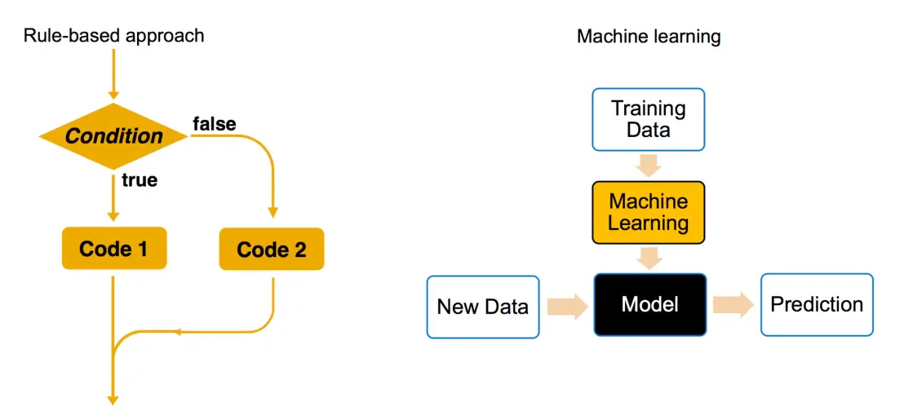

What is machine learning?
Dog 99.99%!

Slide 11
What is cloud computing?
Access services on demand
Avoid large upfront investments
Provision computing resources as needed
Pay only for what you use

Slide 12
What we have
Like-minded Students in NTU
Project Partner / Research Partner
Friends in similar path of personal development
Academic facilities
GPUs
RTX 3090, GTX 2080 Ti, GTX 1080 Ti
Equipments
Robot Master *2
3D printer *1
Drones *1
…
Industrial Connections
Sponsors & Partners
Notes:
MLDA@EEE is a student-led club, that aims to provide a platform to empower NTU students to pursue the application of Machine Learning, Data analytics and artificial intelligence. We do so by providing them with a place to learn, apply and connect with our industry partners and the academia

Slide 13
Cloud Computing Benefits
Variable expenses
Cost optimization
Capacity
Economies of Scale
Speed and agility
Global in minutes

Slide 14
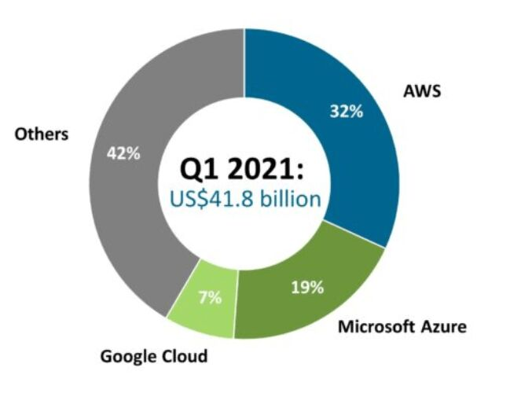
Major Cloud Providers

Slide 15

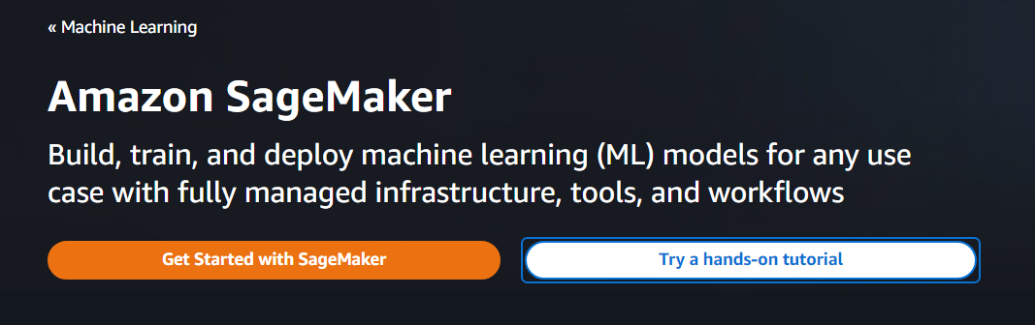
Where does SageMaker fit in?

Slide 16
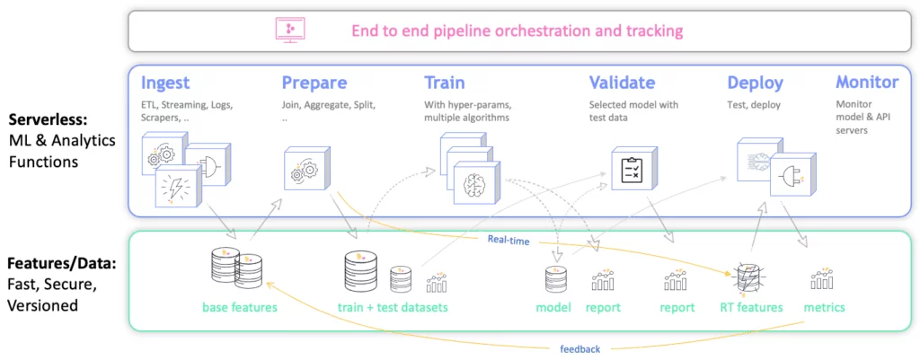
End-to-end ML Pipeline

Slide 17
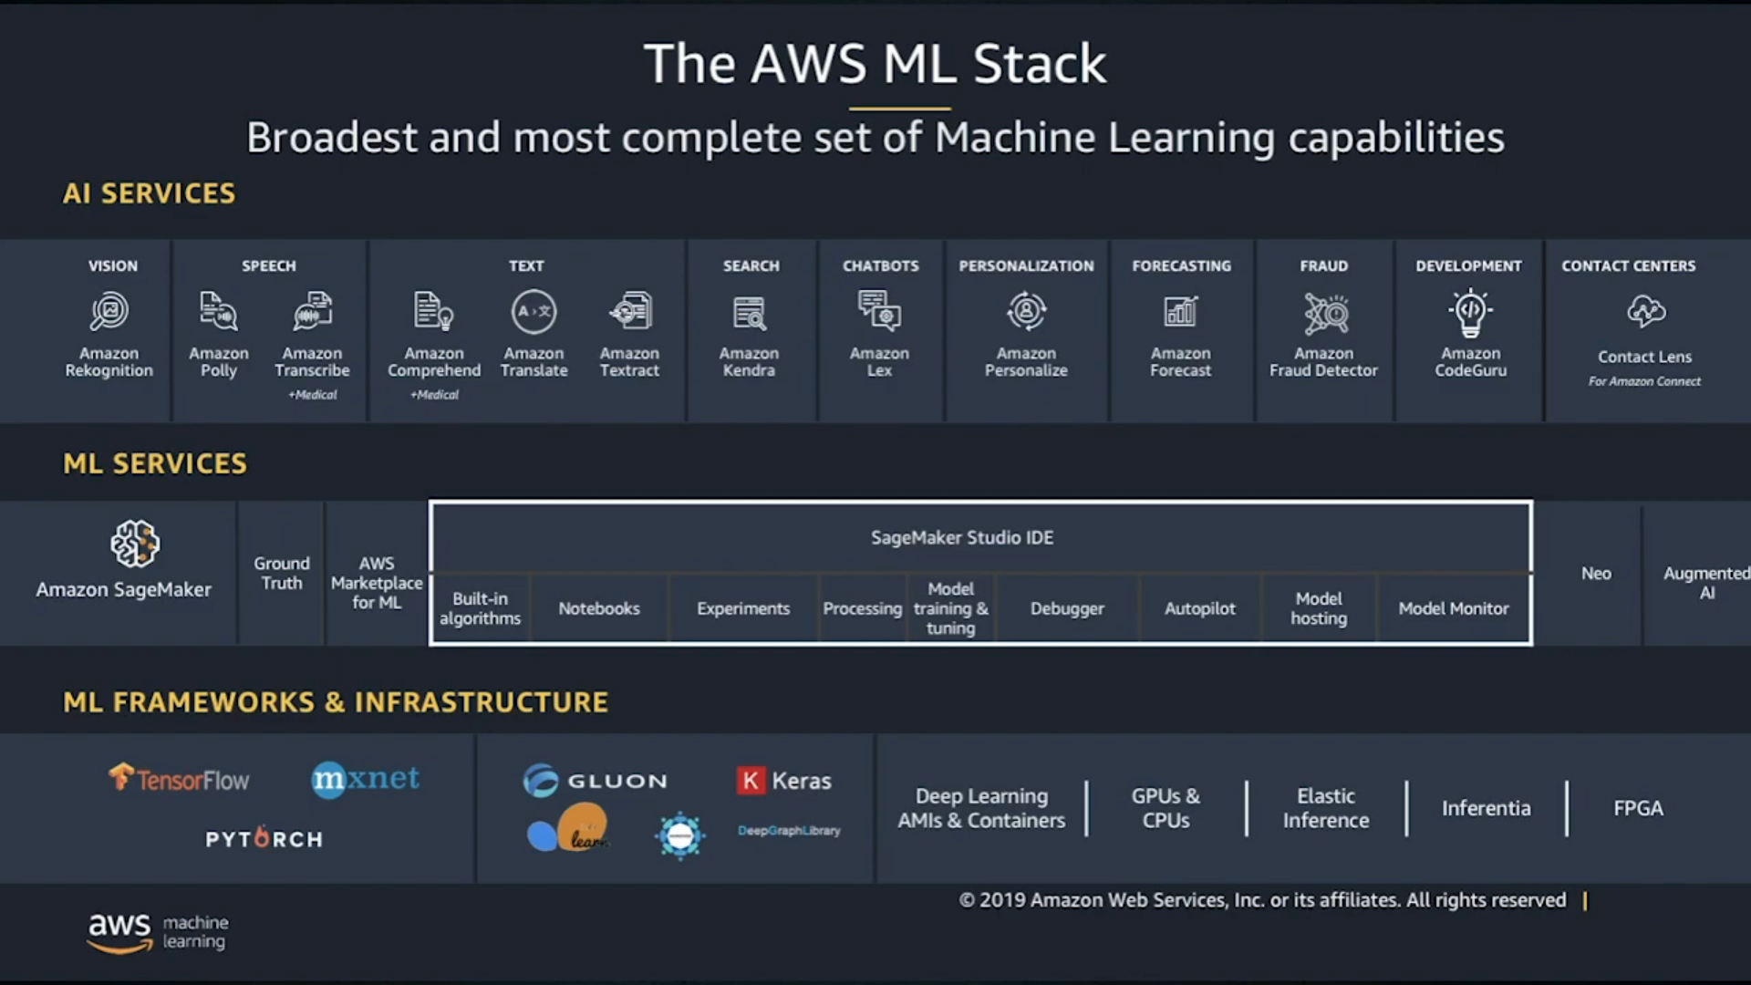

Slide 18
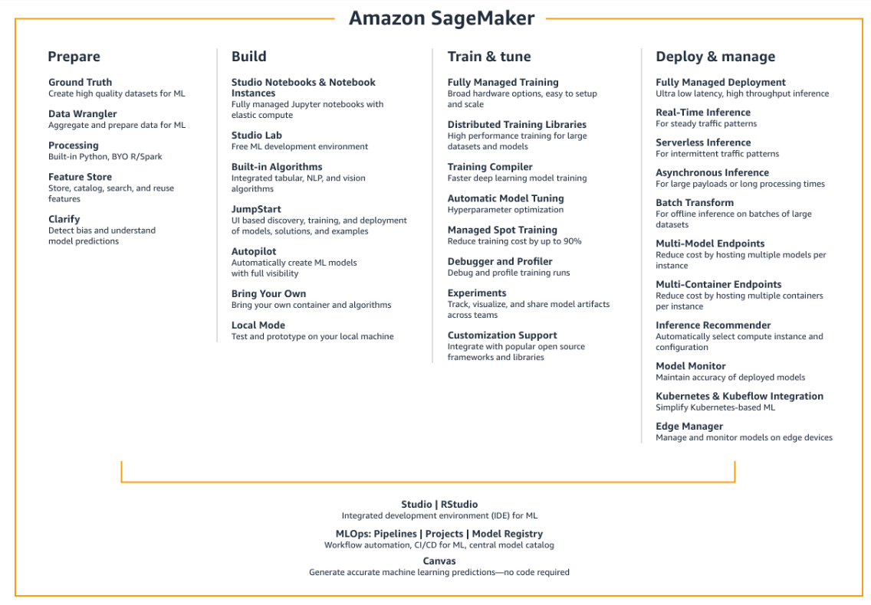

Slide 19
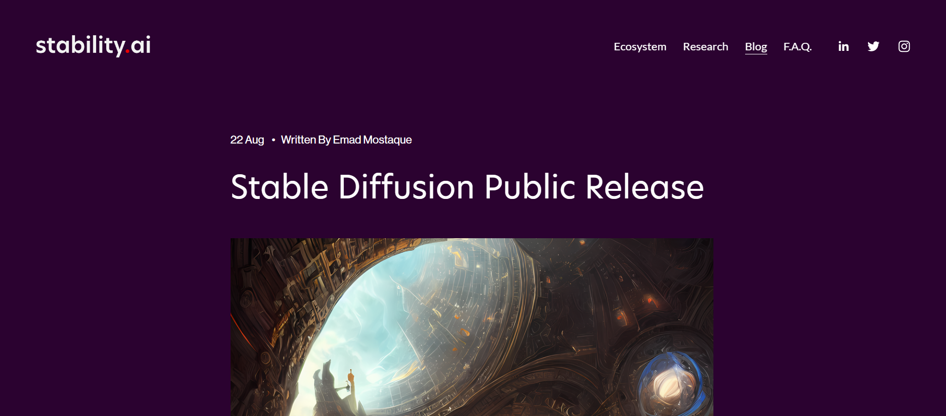
Stability AI: Stable Diffusion

Slide 20
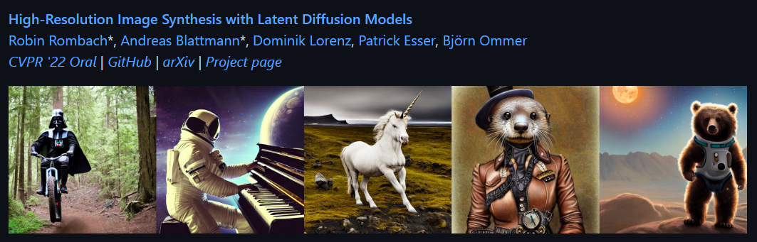
Stability AI: Stable Diffusion - Open Sourced
https://github.com/CompVis/stable-diffusion https://www.youtube.com/watch?v=nVhmFski3vg

Slide 21
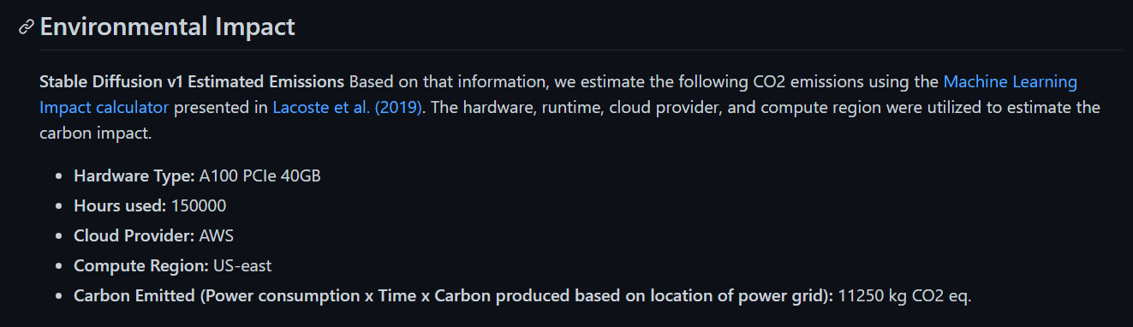
Stability AI: Stable Diffusion - Model Card

Slide 22
02
SageMaker Pricing

Slide 23
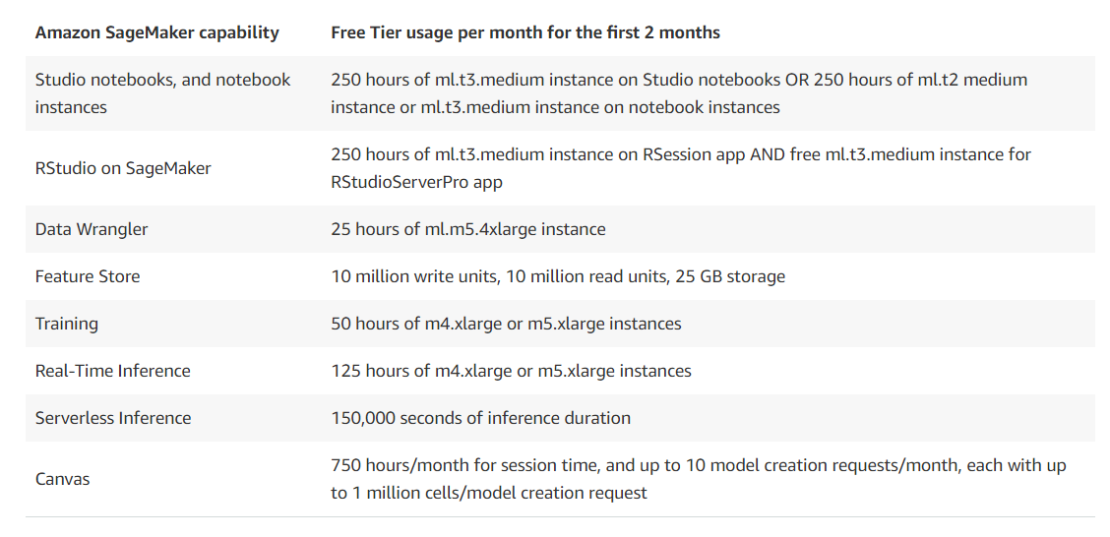
Free Tier - https://aws.amazon.com/sagemaker/pricing/

Slide 24
03
AWS Products

Slide 25
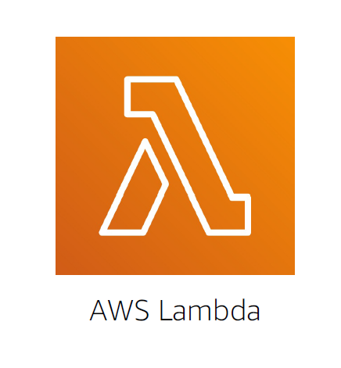
AWS Lambda - Serverless Computing
Run code without provisioning or managing servers
Pay only for compute time while code is running
Use other AWS services to automatically trigger code

Slide 26
How AWS Lambda works
Upload code to Lambda
Set code to trigger from an event source
Code runs only when triggered
Pay only for the compute time you use

Slide 27
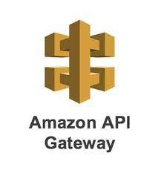
API Gateway
Acts as the "front door" for applications to access data, business logic, or functionality from your backend services.
Handles all the tasks involving:
- including traffic management
- CORS support
- authorization and access control
- throttling and monitoring
- API version management

Slide 28
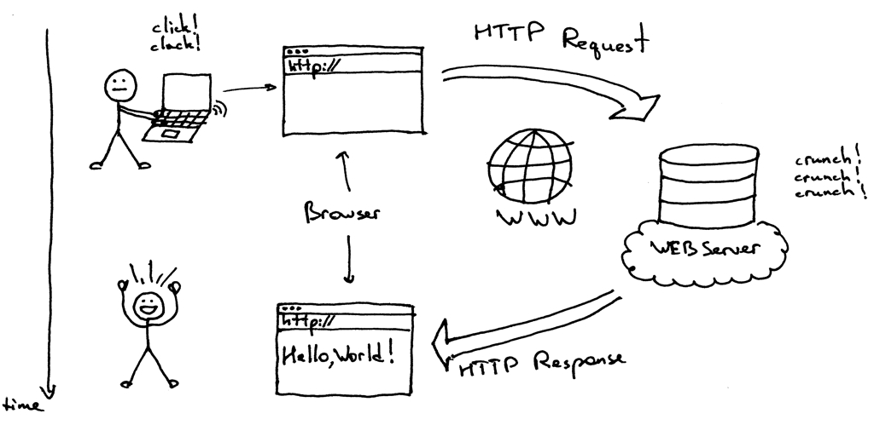
HTTP Methods
Method | CRUD Operation | Meaning
GET | Read | Read data
POST | Create | Insert data
PATCH | Update | Update data
DELETE | Delete | Delete data

Slide 29
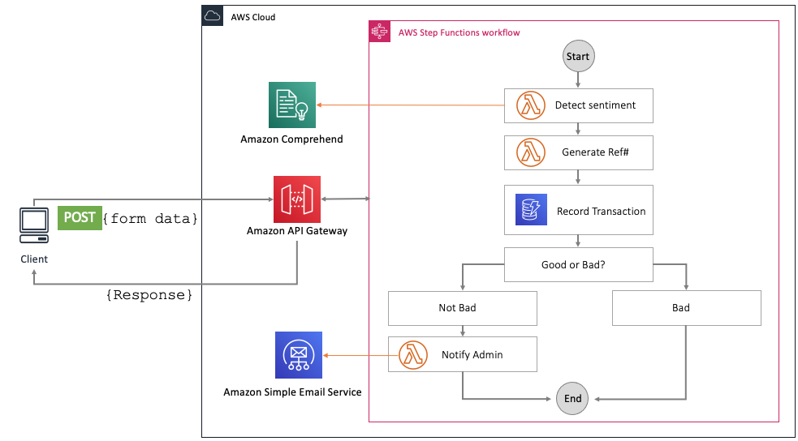

Slide 30

Elastic Container Registry (ECR)
Push container images to Amazon ECR without installing or scaling infrastructure, and pull images using any management tool.

Slide 31
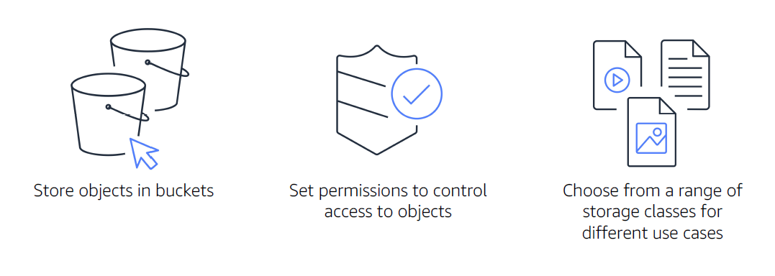
Amazon Simple Storage Service (S3)

Slide 32
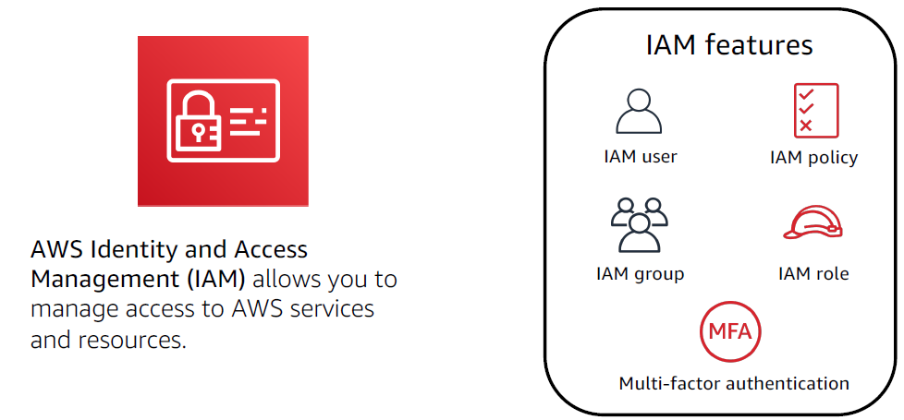
IAM

Slide 33
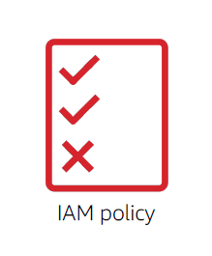
IAM policy
An IAM policy is a document that grants
or denies permissions to AWS services
and resources.
Best practice: Follow the security
principle of least privilege.
Notes:
The principle of least privilege addresses access control and states that an individual should have only the minimum access privileges necessary to perform a specific job or task and nothing more.
Policy types: https://docs.aws.amazon.com/IAM/latest/UserGuide/access_policies.html

Slide 34
04
SageMaker Studio

Slide 35
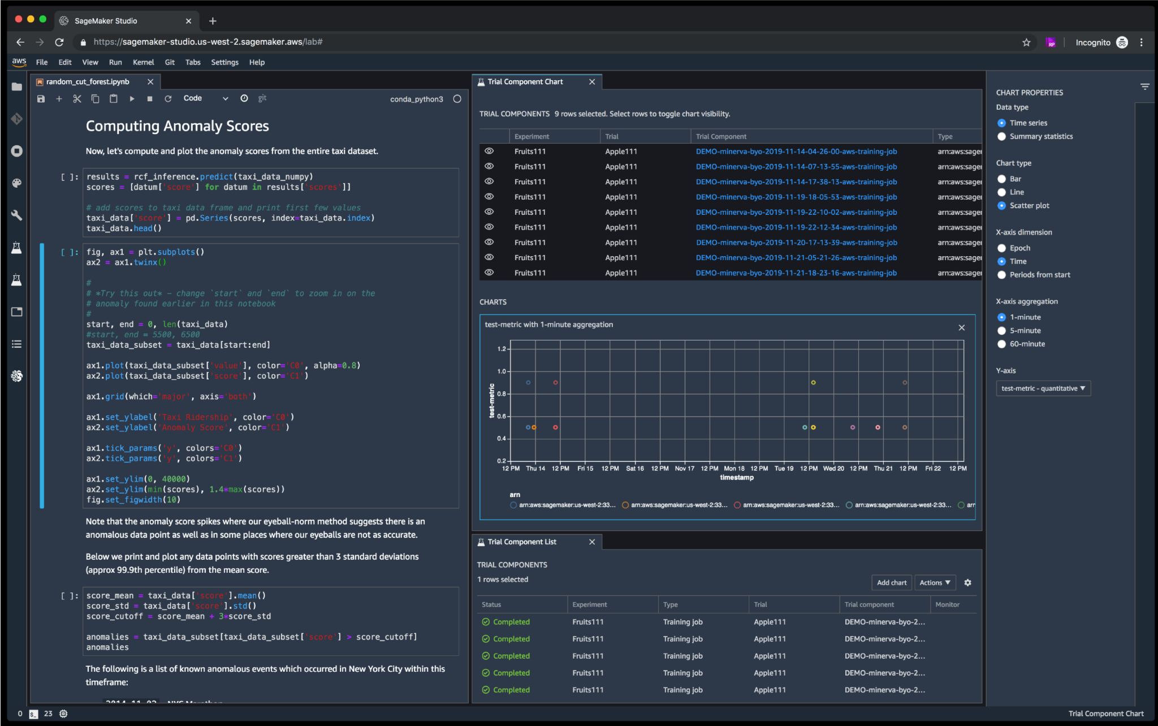

Slide 36
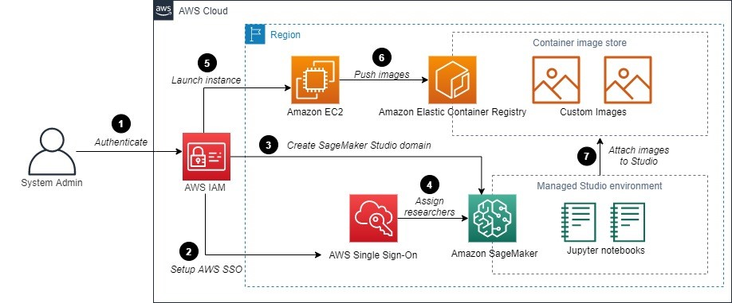
Admin Perspective

Slide 37
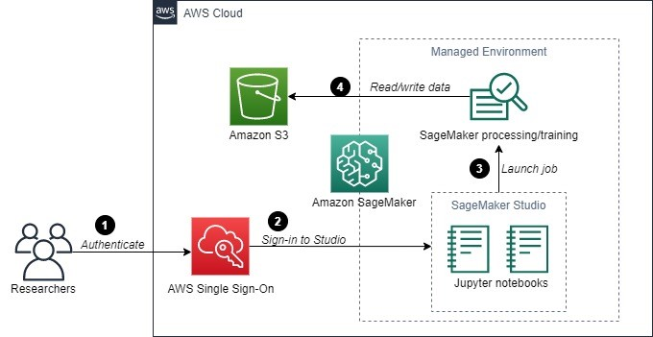
User Perspective

Slide 38
05
Demo + Hands-on

Slide 39
Demo: Labelling Data
https://aws.amazon.com/getting-started/hands-on/machine-learning-tutorial-label-training-data/

Slide 40
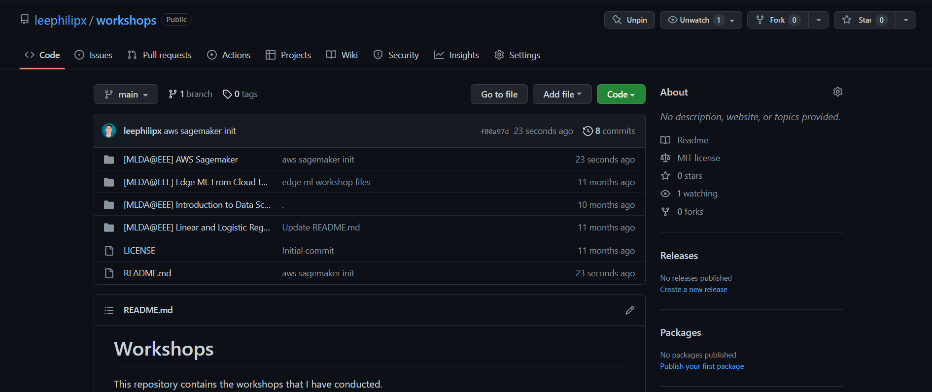
Code Resource - https://github.com/leephilipx/workshops

Slide 41
Hands-on Session

Slide 42
Hands-on: Training the Model
https://aws.amazon.com/getting-started/hands-on/machine-learning-tutorial-label-training-data/

Slide 43
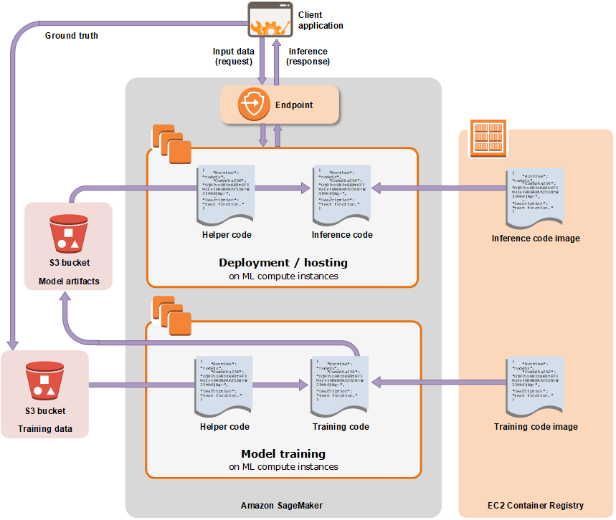
Training a Model
Under the Hood

Slide 44
Hands-on: Endpoint Deployment
https://aws.amazon.com/getting-started/hands-on/machine-learning-tutorial-label-training-data/

Slide 45
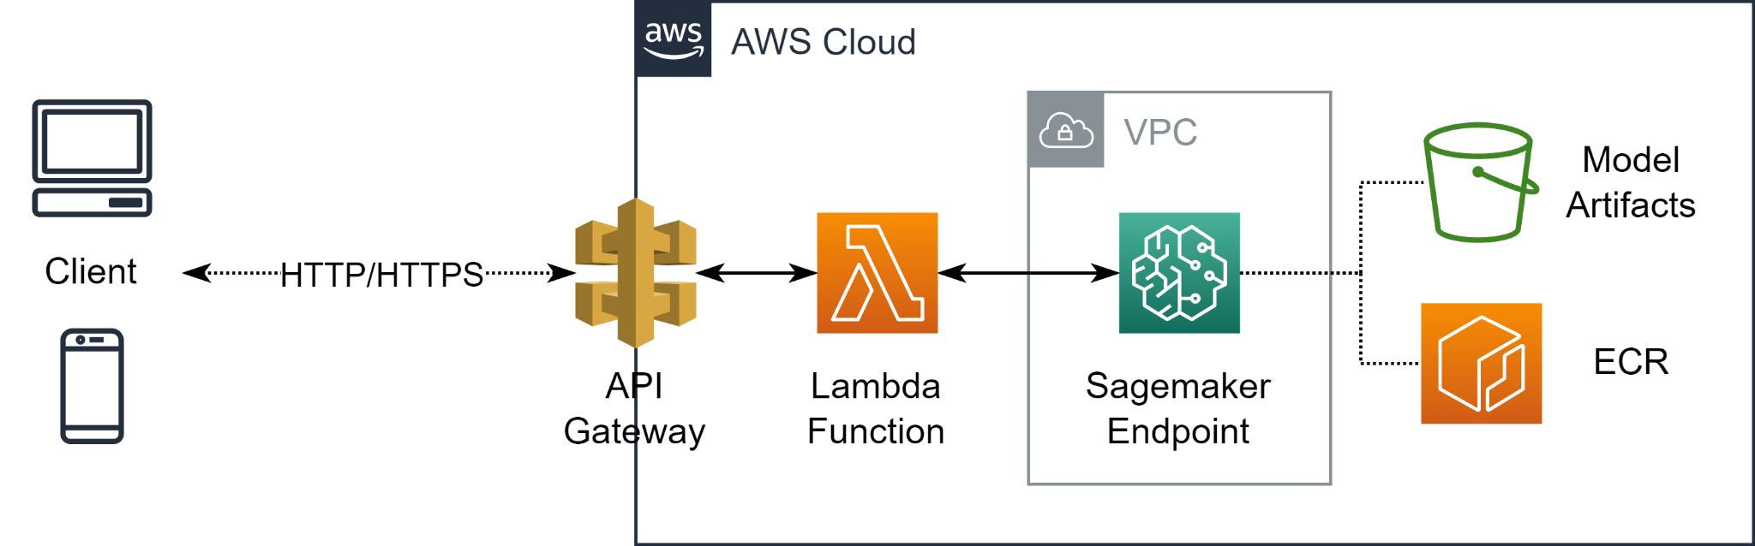
Hands-on: Training & Deploying a Model

Slide 46
Hands-on Session

Slide 47
06
Sample Architectures

Slide 48
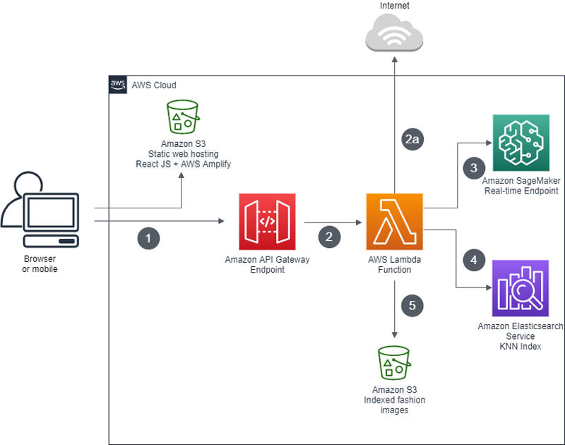
Visual Search Application
https://aws.amazon.com/blogs/machine-learning/building-a-visual-search-application-with-amazon-sagemaker-and-amazon-es/
API Gateway: Extra Setup
API Authentication
Rate-limiting
Resource monitoring

Slide 49
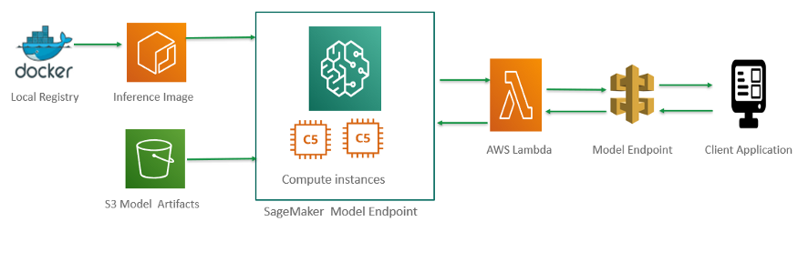
Already have a Docker image?
https://medium.com/@info_91596/deploying-a-custom-machine-learning-model-as-rest-api-with-aws-sagemaker-7216ba600504

Slide 50
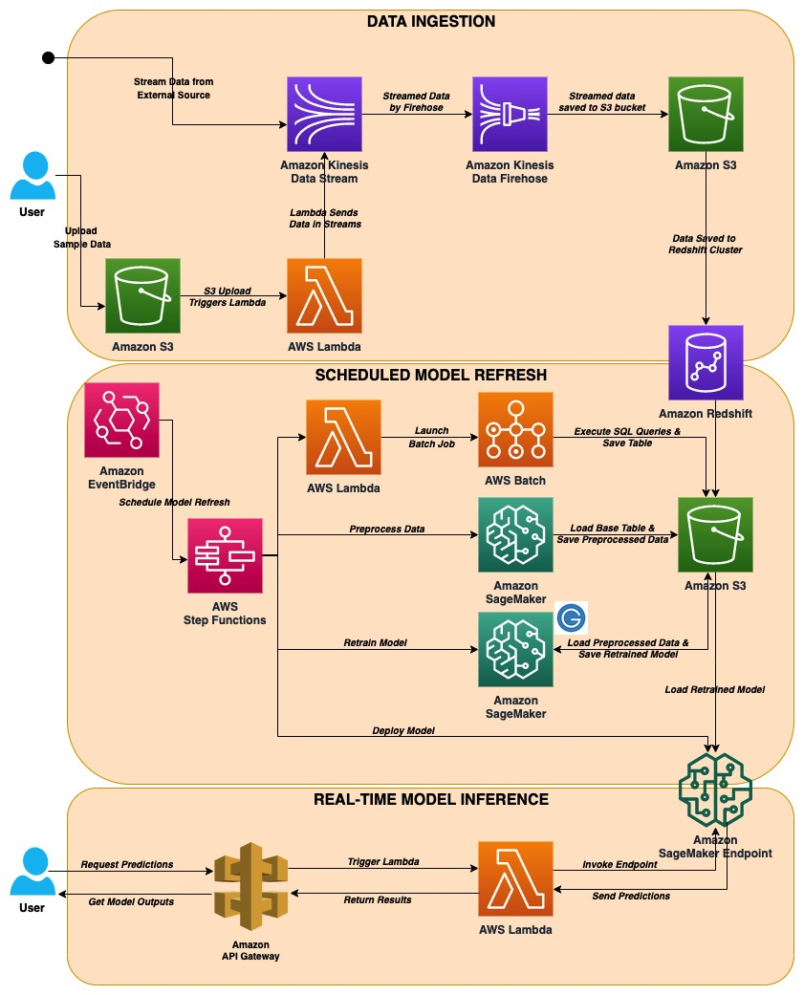
Automated model refresh with streaming data
https://aws.amazon.com/blogs/machine-learning/automated-model-refresh-with-streaming-data/

Slide 51
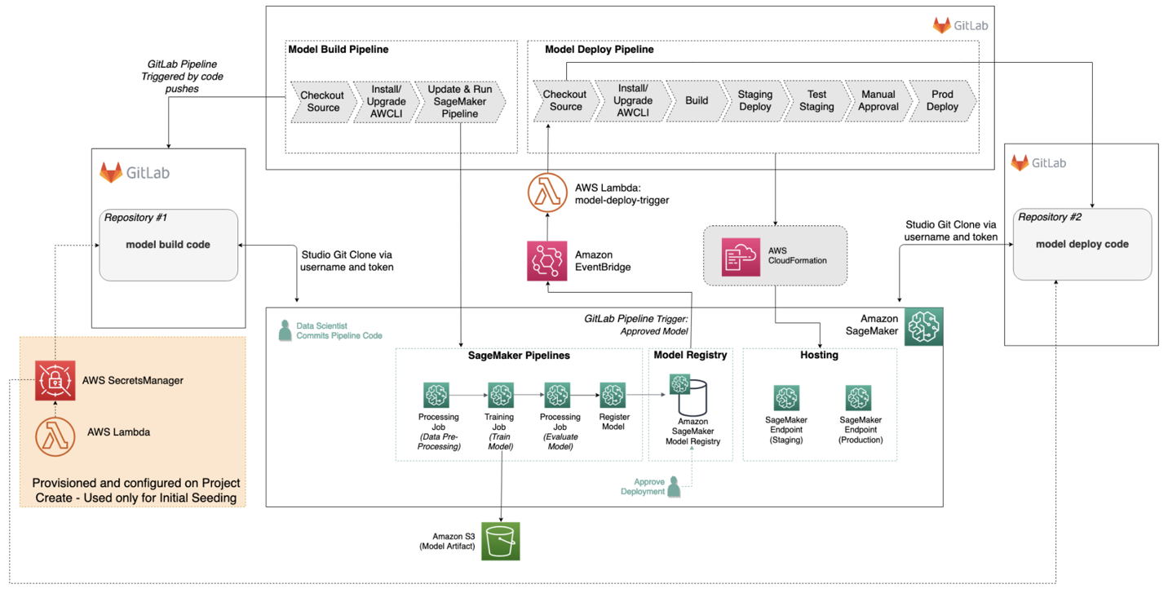
MLOps - CI/CD Pipeline
https://aws.amazon.com/blogs/machine-learning/build-mlops-workflows-with-amazon-sagemaker-projects-gitlab-and-gitlab-pipelines/

Slide 52
07
Cleaning-up

Slide 53
Delete your resources, save your wallet
Remember to free up all resources to avoid shocking bills at the end of the month!

Slide 54
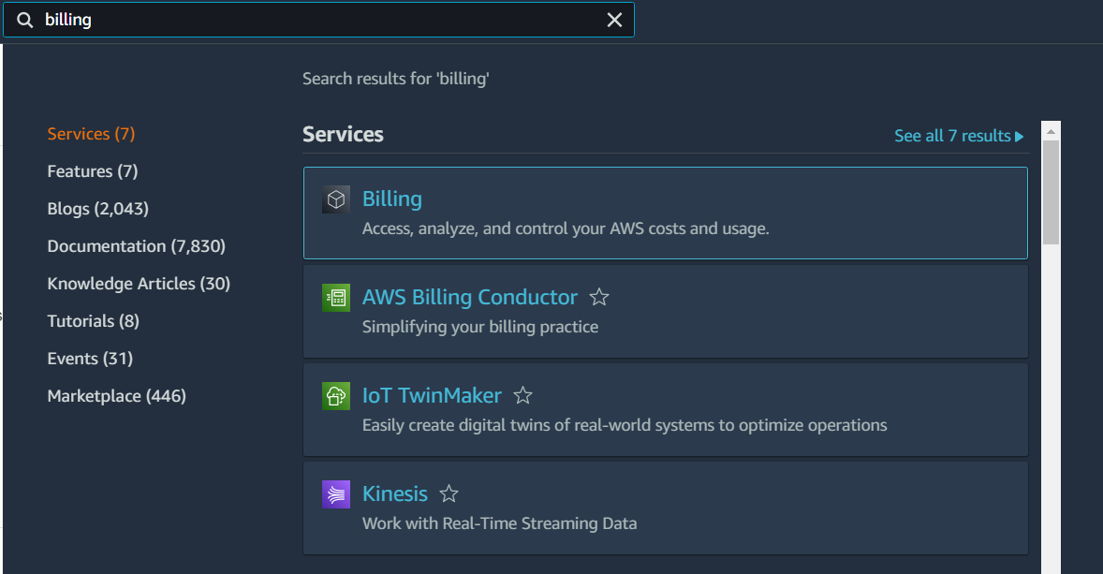
Billings and Budgets

Slide 55
THE END
Thanks for attending!

Slide 56

Please leave your feedback https://forms.office.com/r/zbUEJjEUHJ
Notes:
https://forms.office.com/r/zbUEJjEUHJ

Slide 57
Extra Resources
AWS Official Documentation
AWS Training
AWS Certification
SageMaker Developer Guide
SageMaker Getting Started
Amazon SageMaker Tutorials
Amazon SageMaker 101 Workshop

